Slide 1



RFID Security for IoT Airport Infrastructure
COLLEGE OF BUSINESS, INTELLIGENCE AND SECURITY
COLLEGE OF ENGINEERING
Students:
AARON TULINO (Presenting)
BENJAMIN HIGGINS (Presenting)
PHILIPP SHCHETININ (Presenting)
OWEN GUERRA-MONDRAGON
SAWYER HANSEN
Mentors:
CATALINA ARANZAZU-SUESCUN
LUIS FELIPE ZAPATA-RIVERA

Slide 2
INTRODUCTION
The problem
The airport’s luggage management process has been traditionally supported by paper-based barcodes to identify passengers’ bags. With the help of conveyor belts and multiple barcode readers located along the belt path, these bags are guided to their destination.
In this multi-step process, it is common for bags to get lost or delayed due to different reasons. To mitigate or reduce some of these problems, airports and airlines have been working to implement RFID-based identification of luggage that can be reliably identified.
Notes:
General introduction slide

Slide 3
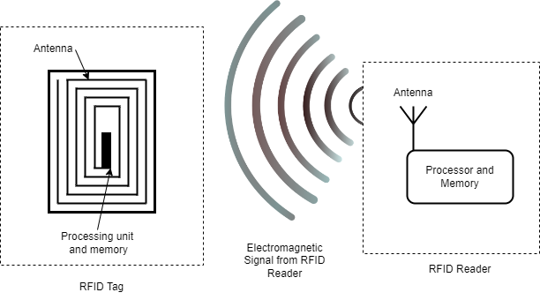
RFID System Components
INTRODUCTION
Notes:
Full text slide

Slide 4
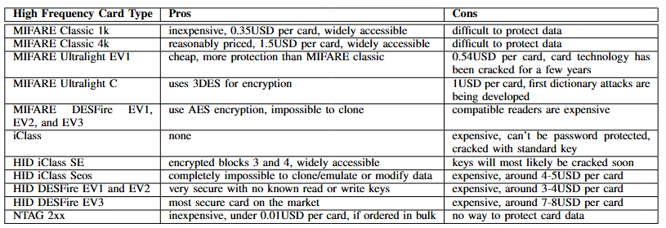
Types of RFID Cards
INTRODUCTION
Notes:
Full text slide

Slide 5

Testbed Implementation
Notes:
Section divider slide
To create a blue image overlay, Change Picture from file
Blue shape must be in front

Slide 6
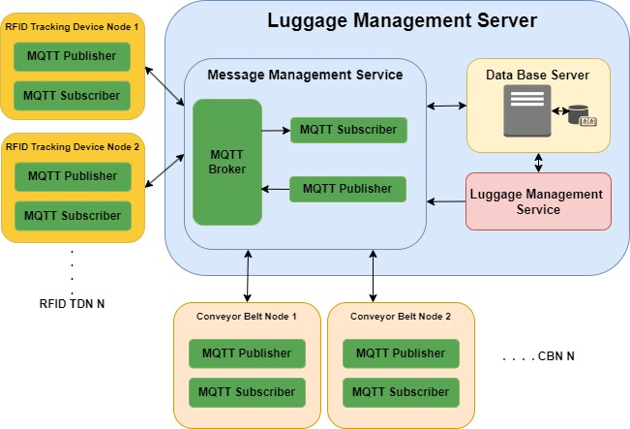
General architecture of the system
TESTBED IMPLEMENTATION
Notes:
Full text slide

Slide 7
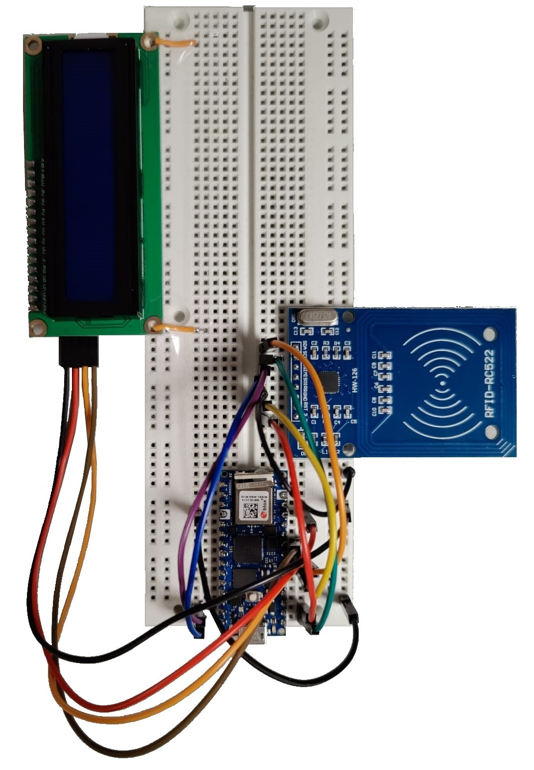
System Implemented: TDN
TESTBED IMPLEMENTATION
The Mifare RFID RC522 modules are connected to the Arduino board over the Serial Peripheral Interface (SPI) as RFID readers.
These readers are used with Mifare Ultralight C RFID tags, which identify luggage passing through the conveyor belt.
A 16x2 LCD with an Inter-Integrated Circuit (I2C) interface is attached to each TDN.
Tracking Device Node (TDN)
Notes:
Full text slide

Slide 8
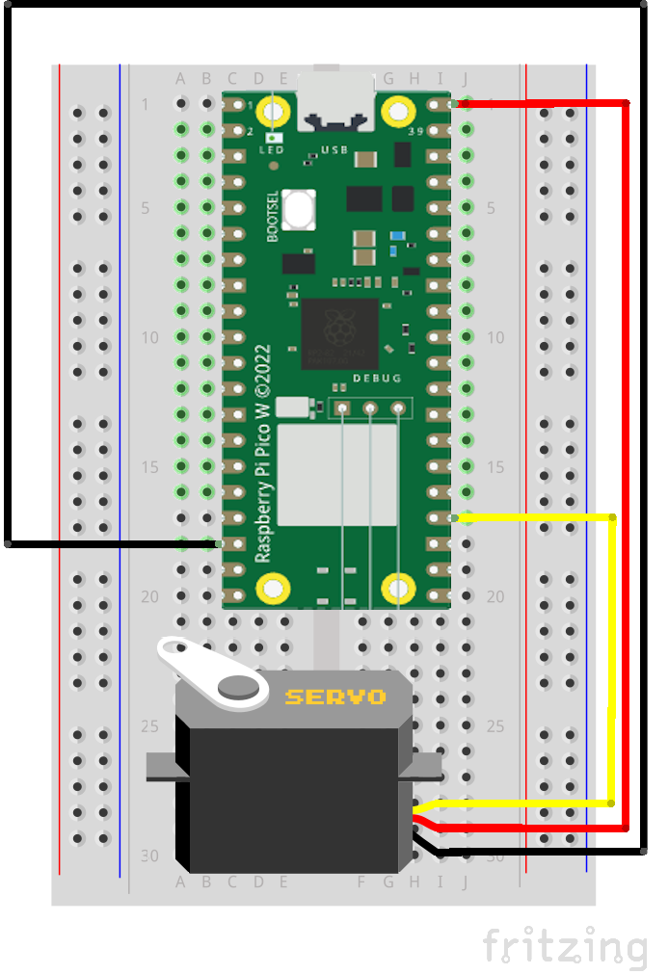
System Implemented: CBN
TESTBED IMPLEMENTATION
CBNs are implemented using a Raspberry Pi Pico W microcontroller and an SG90 9G Micro servo motor that simulates the routing for the luggage on the conveyor belt.
When a message is sent from the Luggage Management Server, the servo motor will take one of three possible actions: rotate left, rotate right, or position its arm in the center.
Conveyor Belt Node (CBN)
Notes:
Full text slide

Slide 9
Vulnerability Assessment and Attacks
Notes:
Section divider slide
To create a blue image overlay, Change Picture from file
Blue shape must be in front

Slide 10
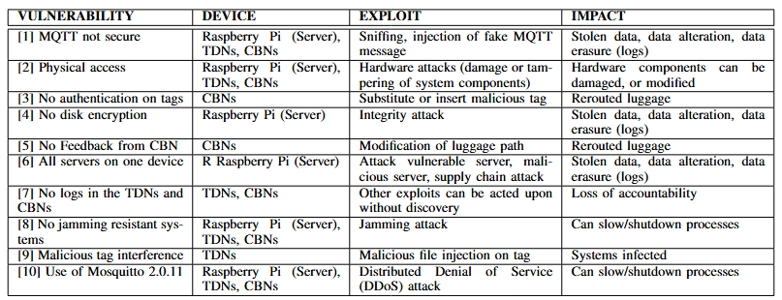
Vulnerability Assessment
VULNERABILITY ASSESSMENT AND ATTACKS
Notes:
Full text slide

Slide 11
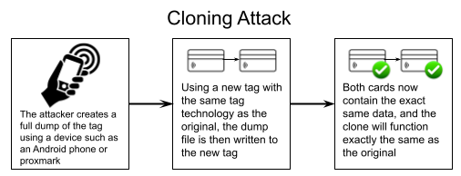
Attacks
VULNERABILITY ASSESSMENT AND ATTACKS
Notes:
Full text slide

Slide 12
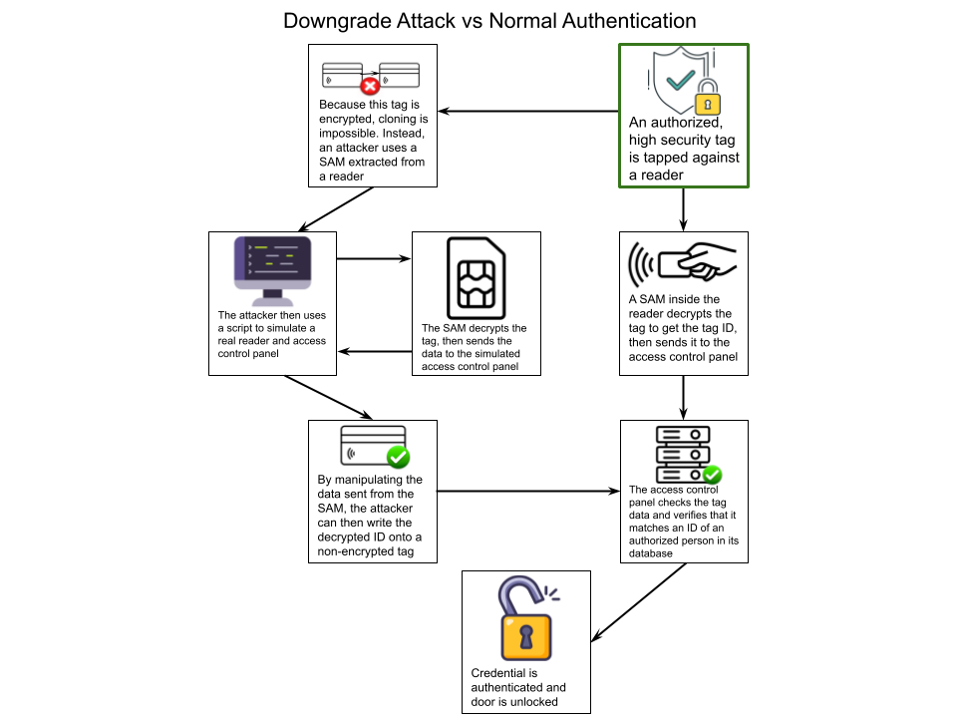
Attacks
VULNERABILITY ASSESSMENT AND ATTACKS
Notes:
Full text slide

Slide 13
Security Recommendations and Future Work
Notes:
Section divider slide
To create a blue image overlay, Change Picture from file
Blue shape must be in front

Slide 14
Security Recommendations
SECURITY RECOMMENDATIONS AND FUTURE WORK
Use Secure MQTT protocol to transmit the commands
Use encryption mechanisms for transmitting the data
Use an encryption mechanism on the tags
Create logs for the actions of the TDN and CBN
Use tags that are password protected
Only enable the tag technology that is in use; disable legacy/unsecure tag technologies
Have transactional logs in the database
Notes:
Full text slide

Slide 15
Future Work
SECURITY RECOMMENDATIONS AND FUTURE WORK
As a future work, it is planned to expand the context of the project from luggage tracking to physical access control systems.
Also, evaluate the security of access control in industry and corporate settings.
Notes:
Full text slide

Slide 16
Demos
Notes:
Section divider slide
To create a blue image overlay, Change Picture from file
Blue shape must be in front

Slide 17
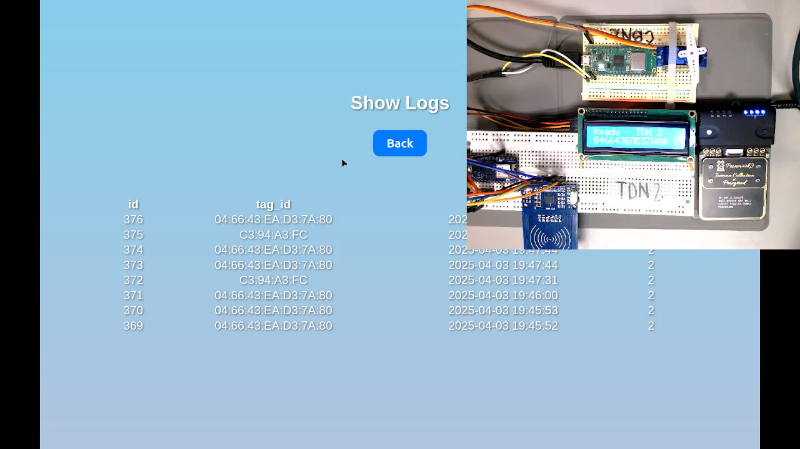

Slide 18
